Slide 1
Estimating The Duration Of Exposure For Individual Prescriptions When Days Of Supply Are Not Available: Introducing the wtdR package.
Augusto Ferraris, MD, MPH
Floria Nyandaya, MD, MPH
12th December 2024

Slide 2
Overview
Why is this package needed?
Package functions: create_wtd
Package functions: summary_wtd
Package functions: plots

Slide 3



The Premise Of Waiting Time Distribution (WTD)
In pharmacoepidemiology, defining the duration of exposure to medications is a central feature of study design.
The number of days of supply of filled prescriptions are frequently used to define exposure time of individual prescriptions.
When the number of days of supply are not available or they are unreliable, researchers make arbitrary decisions to define duration of exposure.

Slide 4
Waiting Time Distribution - Why It Is Useful
The waiting time distribution is a data-driven approach to approximate the duration of exposure for individual prescriptions.
It is particularly useful for long-term treatments of medications with homogeneous indications, for example, antidementia drugs (only used to treat dementia, must be filled regularly with little variation in dose).
Better than researcher driven decisions?

Slide 5
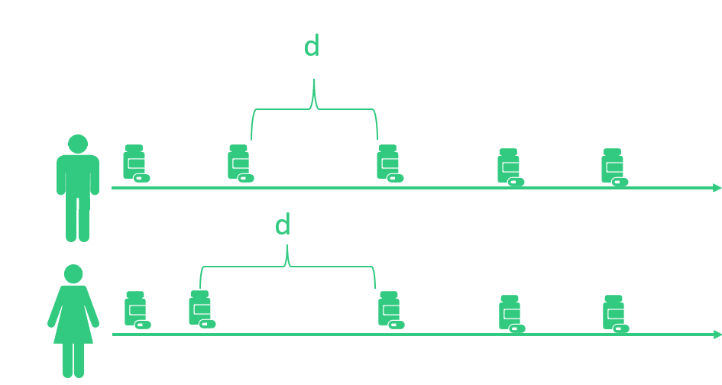
WTD: How It Works
Sounds complicated – it’s not!
Our objective is to measure the duration of supply (d) of individual medications, that is, the time between prescriptions filled.
The quantity can vary between users, but it follows a similar pattern

Slide 6
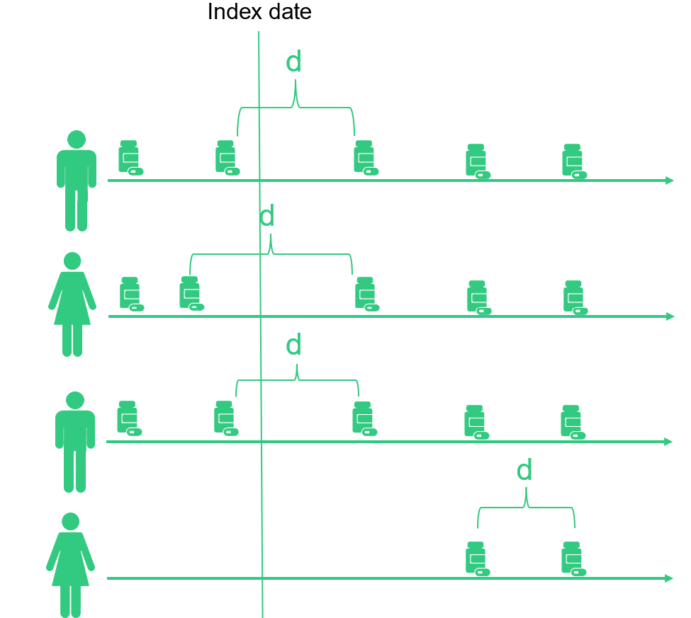
WTD: How It Works
Sounds complicated – it’s not!
We can take a time-window and select a random date to start counting the time until the first prescription is filled by each individual.

Slide 7
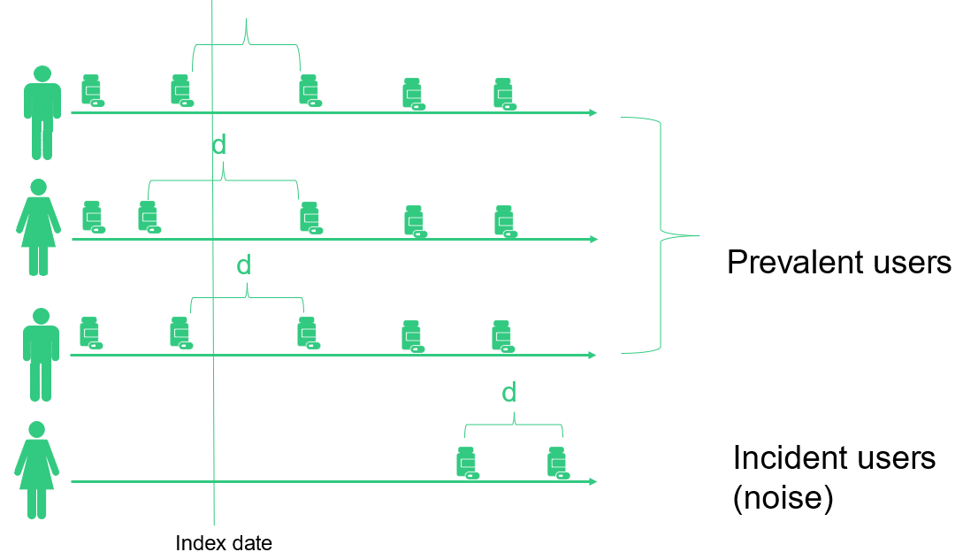

Slide 8
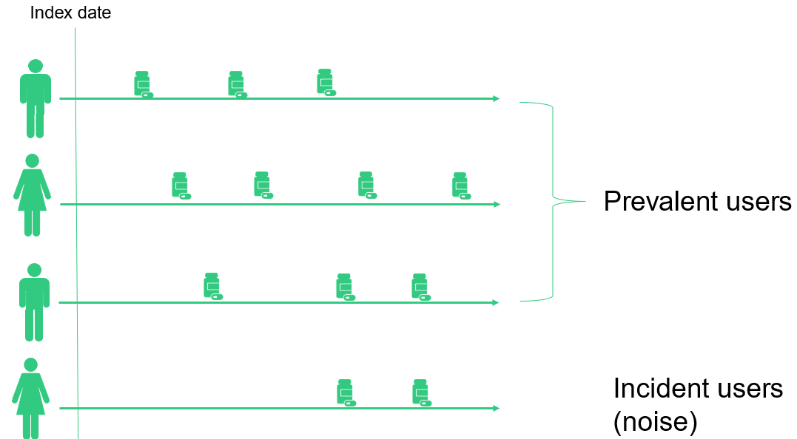

Slide 9
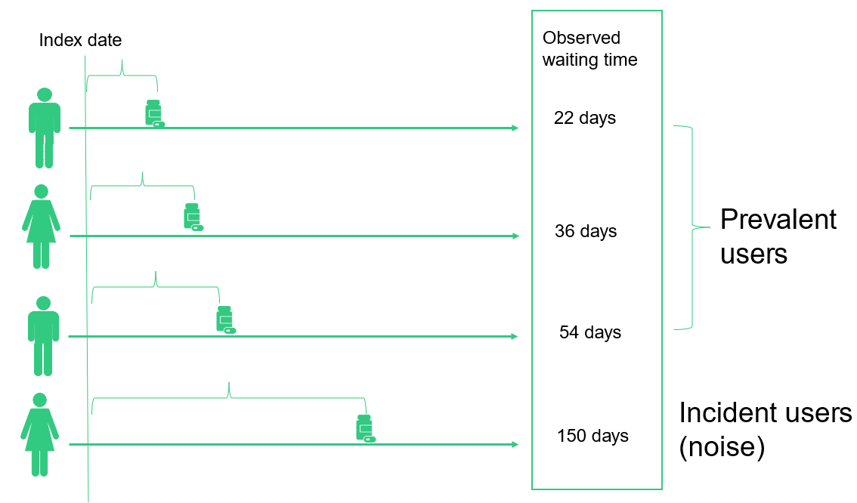

Slide 10
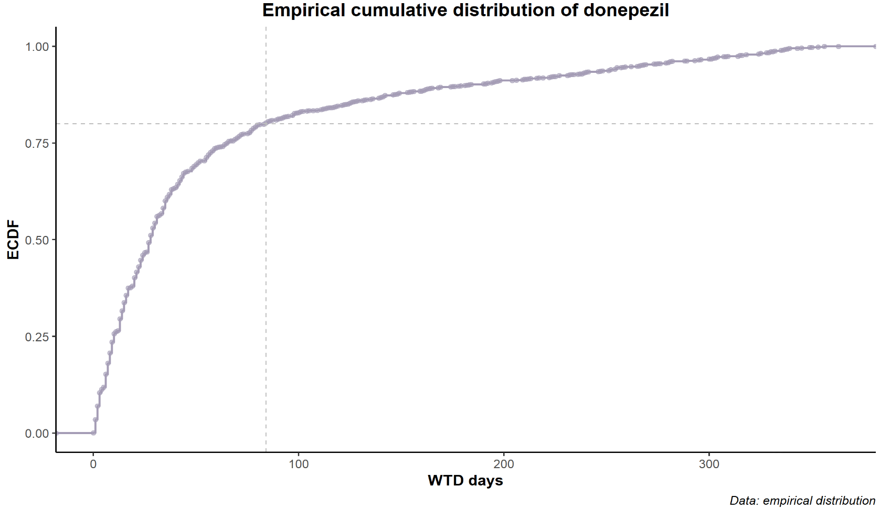
Defining The Duration Of Exposure To Individual Prescriptions
The 80th percentile has been proposed to define a (fixed) duration of exposure to individual prescriptions.

Slide 11
WTD Variations
Variation | Change | Advantage
Prevalent users-only WTD | Keeps only patients with prescriptions in the previous year | Improves precision by dropping Incident users.
Reverse WTD | Changes the index date to the LAST day of the time window | Allows for estimating the rate of discontinuation
Random-index WTD | Defines a random date within the time window for each patient | Accounts for seasonal stockpiling
Parametric WTD | Models the d parameter using log transformation and then linear regression (normal distribution after transformation) | Can adjust the estimation of d according to covariates (e.g., dementia, sex)

Slide 12
The wtdR package powered by data.table()

Slide 13
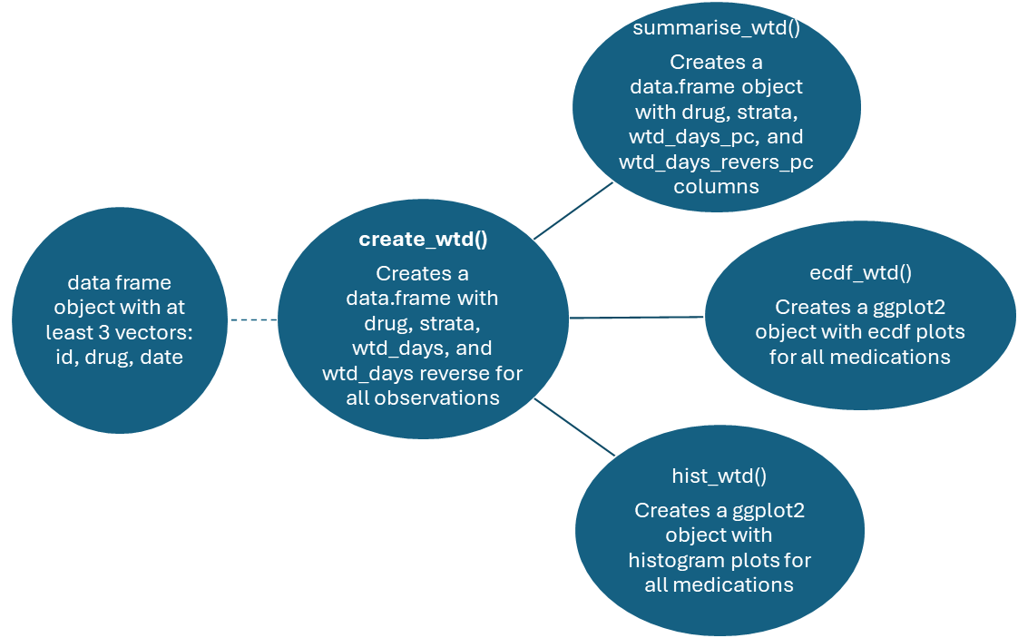
How It Works

Slide 14
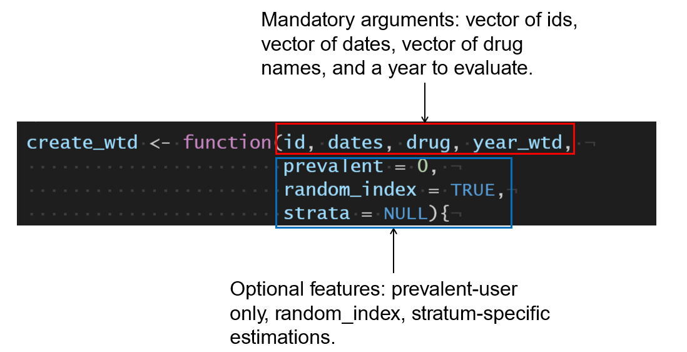
1. create_wtd() function

Slide 15
1. create_wtd() function - errors
What errors can it detect and how does it handle it?
Error | How it handles it
Input objects (id, drug, dates) are not vectors | STOP and issue warning stating how data must be entered
Input objects (id, drug, dates) have different lengths | STOP and issue warning stating how data must be entered
Dates vector is a character | Format as.Date()
Presence of NAs in the input object | Removes NAs, and issues a warning stating how many observations were removed
Number of prescriptions in the “prevalent” option is not numeric | STOP and issue warning stating how data must be entered

Slide 16
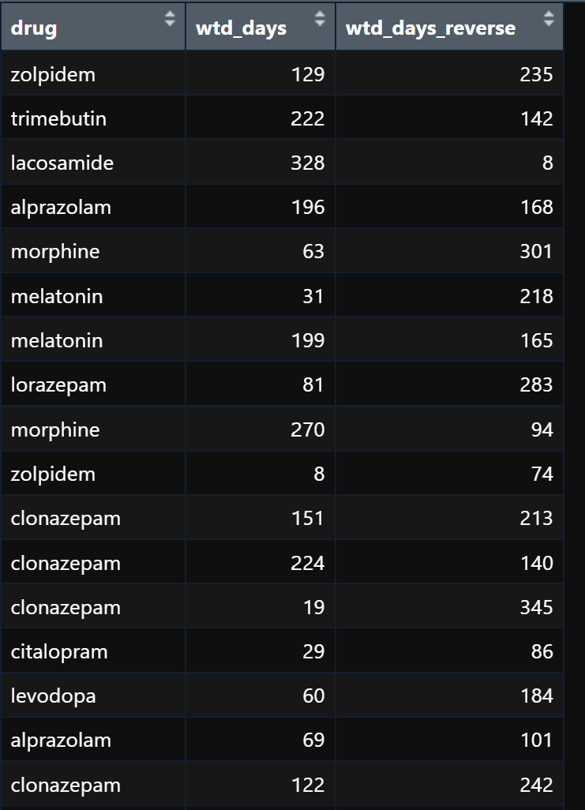
create_wtd()
output

Slide 17
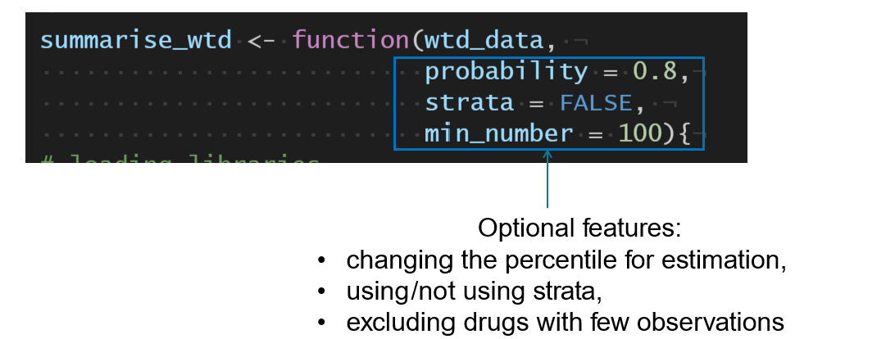
2. summarize_wtd() function
Using the output of create_wtd(), this function creates a data.frame() summary of WTD distribution, stratified (or not) by variables of interest.

Slide 18
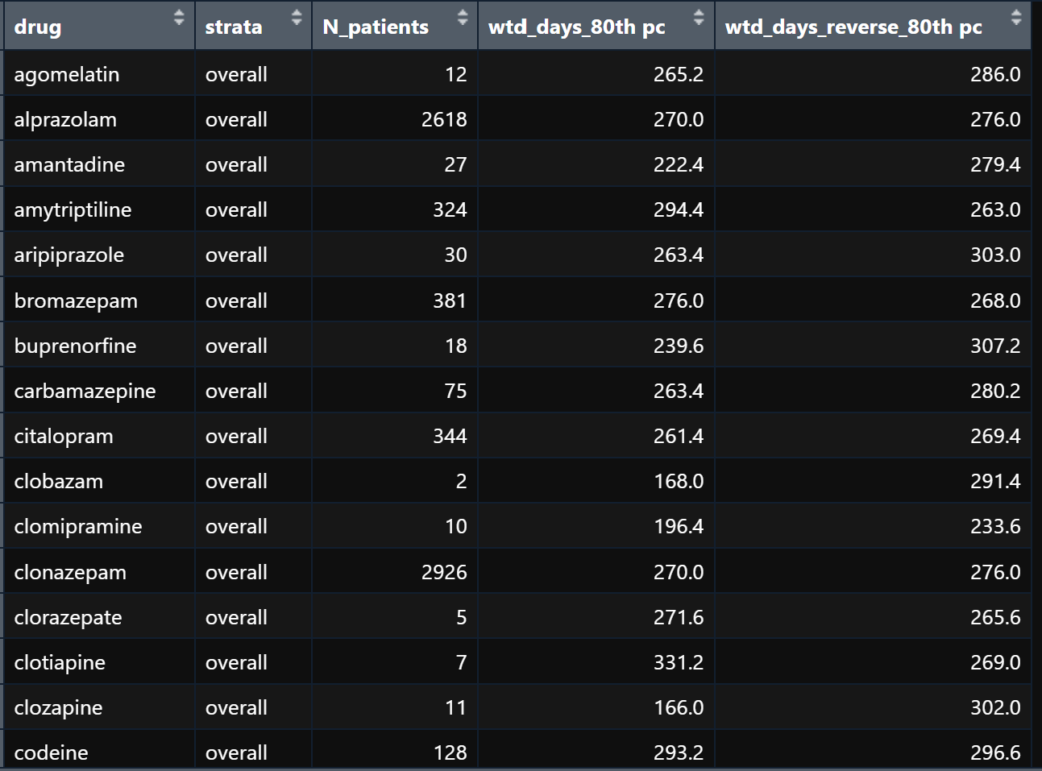
summarize_wtd()
output

Slide 19
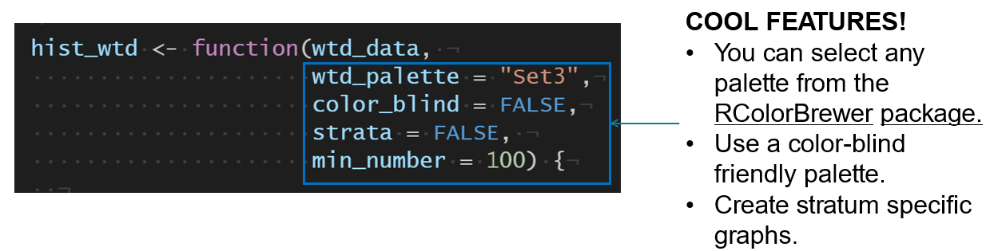
3. ecdf_wtd() and hist_wtd() functions
Using the output of create_wtd(), these functions create a list() object of ggplot2 objects, compiling ecdfs and histograms of the WTD distributions for each drug, and an “overall” graph using ~facet wrap.

Slide 20
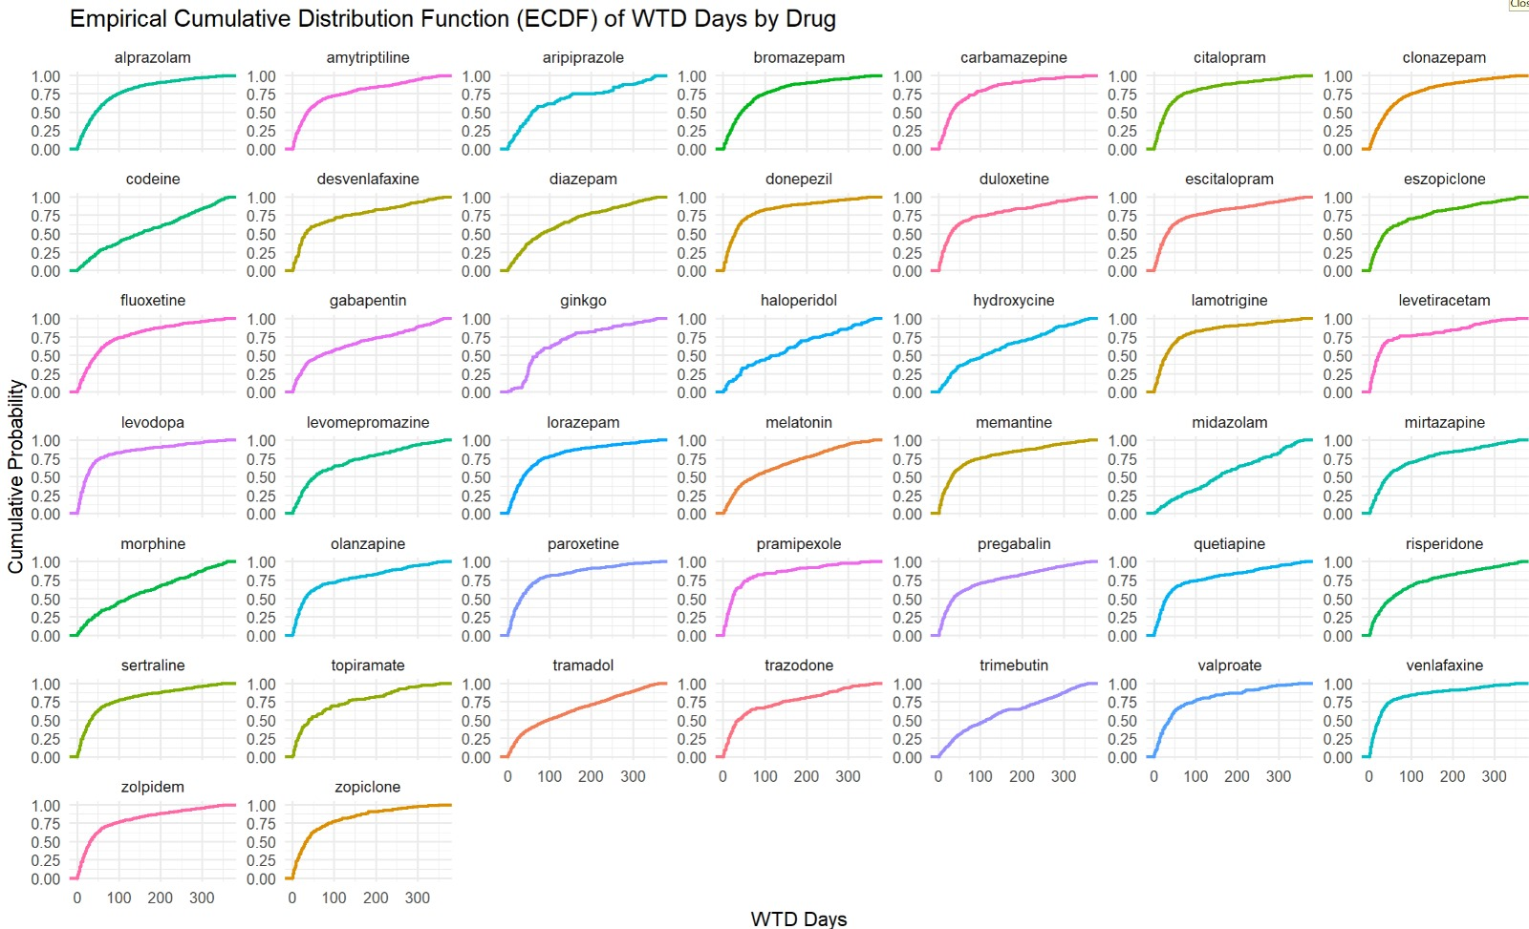

Slide 21
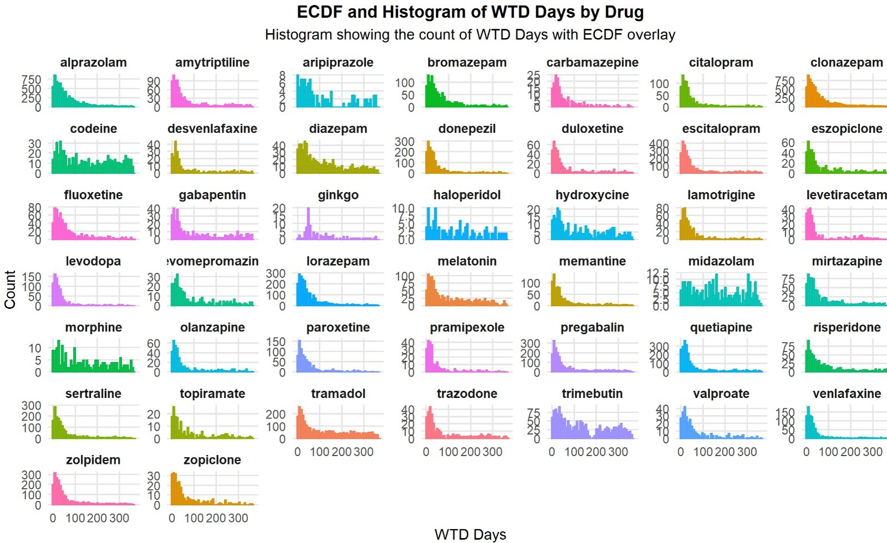

Slide 22


Slide 23

The End

